Slide 1
The Effects of Organic Nutrients on Biological Oxygen Demand in the Hudson River
Sierra Raglin, Nyack High School
Sheean Haley, Woods Hole Oceanographic Institute

Slide 2
Introduction
Over the past decades, water pollution has been increasing as human activities and technology evolve.
Eutrophication leads to the enrichment of an aquatic environment with nutrients from runoff and other contaminants.
Micro algae, like phytoplankton, are the basis of marine ecosystems. If phytoplankton are harmed by human activities, the ecosystem as a whole can be damaged.

Slide 3
Introduction Cont.
When phytoplankton experience eutrophication, the excess nutrients can accelerate algal blooms, and cause Harmful Algae Blooms, or Hypoxia.
Hypoxia is a condition in which an aquatic environment is depleted of dissolved oxygen, which is necessary for all marine life.
It has been shown that inorganic forms of nitrogen and phosphorus from fertilizer and sewage runoff can lead to accelerated algae blooms and hypoxia.
Accelerated phytoplankton growth can affect the environments Biological Oxygen Demand (BOD): the environments need for dissolved oxygen.
It has not been shown whether or not organic forms of nitrogen can lead to an increase in Biological Oxygen Demand, or hypoxia.

Slide 4
Vocabulary
Phytoplankton - microscopic marine algae
Hypoxia - reduced dissolved oxygen content detrimental to aerobic organisms
Dead Zone - an area of the ocean depleted of dissolved oxygen
Eutrophication - excessive richness of nutrients in a body of water due to anthropogenic or natural runoff
Biological Oxygen Demand (BOD) - the amount of dissolved oxygen needed by aerobic biological organisms

Slide 5
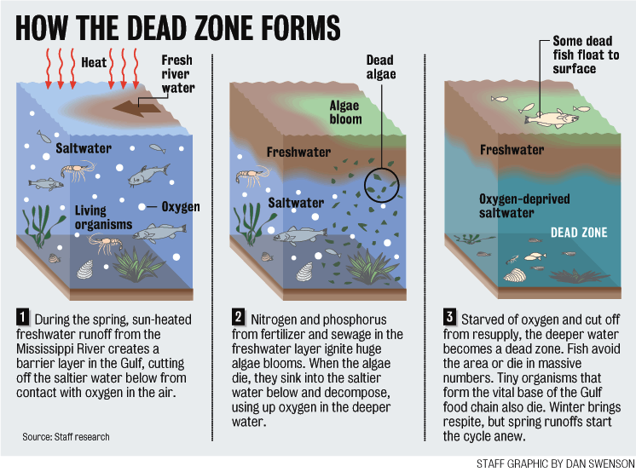

Slide 6
Review of Literature
Found that under certain conditions, bacteria will find and utilize certain organic compound sources. Ulla Li Zweifel, Bo Norrman, Åke Hagström, 1993
Nitrate can cause many different environmental issues, like Harmful Algae Blooms, by increasing phytoplankton growth. Tom Berman and Sara Chava, 1999

Slide 7
Purpose
This study looks to understand the effects that anthropogenic nutrients have on marine ecosystems.
This was done by investigating the effects of different organic nutrients on the natural phytoplankton (and bacterial) communities in the Hudson River and their potential role in Biological Oxygen Demand (BOD).

Slide 8
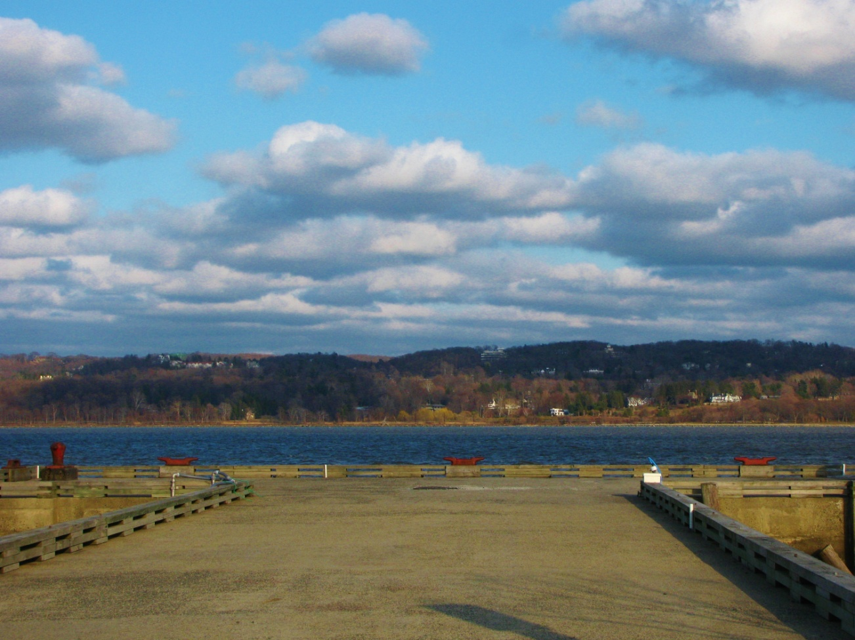
Methodology
Twelve 250 mL water samples were collected from the Piermont Pier, in Piermont, New York.
To simulate runoff, samples were treated with one of three nutrients solution, or no solution at all (control).

Slide 9
Methodology Cont.
The eight of the samples were treated as follows:
Sample Name Nutrient Condition Urea Light 92µL of Urea Exposed to the Light Urea Dark 92µL of Urea Shielded from Light Lysine Light 125µL of Lysine Exposed to the Light Lysine Dark 125µL of Lysine Shielded from Light Nitrate Light 250 µL of Nitrate Exposed to the Light Nitrate Dark 250 µL of Nitrate Shielded from Light Control Light No Nutrient Exposed to the Light Control Dark No Nutrient Shielded from Light

Slide 10
Methodology Cont.
Urea (CH₄N₂O), and Lysine (C₆H₁₄N₂O₂ ) were chosen because they are organic forms of nitrogen that may be present in fertilizer or sewage runoff.
Nitrate (NO₃) is an inorganic form a nitrogen that is present in fertilizer and sewage runoff. It was used to compare the effects of organic nitrogen to inorganic nitrogen.

Slide 11
Methodology Cont.
Three of the samples were labeled as T=0 (time equals zero), and were used to take initial measurements of the water at the beginning of each trial.
The last sample was used to calibrate the DO and pH Probes.
On the collection day, T=0 bottles were measured for DO, salinity, pH, temperature, percent saturation, and chlorophyll-α.
After, the eight treated samples were then incubated for 5 days.
After the incubation period, these samples were each measured, one-by-one for DO, pH, temperature, salinity, percent saturation, and chlorophyll-α.

Slide 12
Results
Figure 1 – Growth rate is indicated by the green bar. The lysine growth rate is at -0.00226 µ. The Control bar is at 0.010786 µ. Urea is close behind control at 0.010703µ.

Slide 13
Figure 2 – Biological Oxygen Demand and gross photosynthesis of the Light bottles. The greatest biological oxygen demand was in the Lysine bottle, due to the bacterial decomposition of the excess phytoplankton, and the absorption of the dissolved oxygen.

Slide 14
Figure 3 – Dissolved oxygen of Light bottles. The Lysine Light bottle had below 1 DO mg/L (0.2mg/$L)$indicating hypoxic conditions. Lack of dissolved oxygen can be an indication of lack of photosynthesis and the decomposition of phytoplankton.

Slide 15
Results
Nitrate had a higher photosynthetic rate than respiration rate, indicating that there was an increase in dissolved oxygen.
Urea had a slightly lower DO than Nitrate and Control.
Lysine Dark had the lowest growth rate.
BOD was highest in the Lysine bottles.
Lysine had an average DO level of 0.2 mg/L

Slide 16
Discussion
BOD was greatest in the Lysine treated samples showing a decreased rate of photosynthesis and an increased rate of respiration. - The bacteria in the samples utilized the carbon in the lysine.
Lysine is an amino acid and can increase the growth rate of bacteria, which in turn will increase respiration rate, absorption of DO, and the consumption of organic matter.
The Lysine Light had an average DO of 0.2 mg/L, indicating hypoxic conditions. This can show that there was a lack in photosynthesis and a high level of decomposition of phytoplankton.

Slide 17
Discussion Cont.
The final average of DO for Urea Light was 12.6 mg/L. However BOD was slightly higher than the gross photosynthesis (only a 0.1 mg/L difference).
Nitrate slightly increased BOD, but results show that nitrate did not cause hypoxia.

Slide 18
Conclusion
Through this study, it can be shown that organic nutrients, like lysine or other amino acids, greatly increased the BOD of Hudson River water samples.
Further research to test organic forms of nitrogen found in the Hudson River over a long period of time (weeks or months), is recommended.
This experiment was conducted in February. Completion of this experiment during warmer months might result in more conclusive data.

Slide 19
Conclusion cont.
Many organisms are impacted negatively by anthropogenic nutrient input.
Many organisms will die and the food web will be altered if issues, like eutrophication, are not prevented.
It is crucial to understand the effects that different inorganic and organic nutrients, as well as human aquatic pollution, have on ecosystems, in order to develop ways to prevent detrimental marine environment changes.

Slide 20
Acknowledgments
I would like to thank Ms. Foisy and Mrs. Kleinman, my science research teachers.
I would also like to thank Sheean Haley of Woods Hole Oceanographic Institute for helping me in developing and conducting my experiment.
I would also like to thank Dr. Andrew Juhl of Columbia University for allowing us to use his laboratory and equipment.

