Slide 1
Differences in percent weight growth of the Mustard Hill coral (Porites astreoides) from contrasting thermal environments after adaptation in a “common thermal garden”
Pratima Rosen

Slide 2
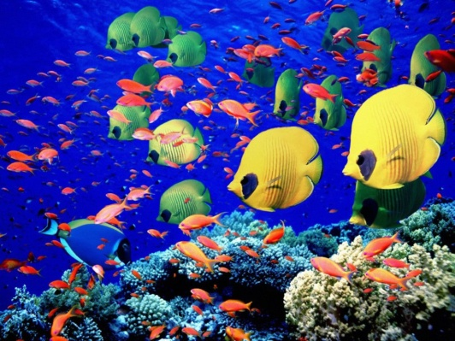
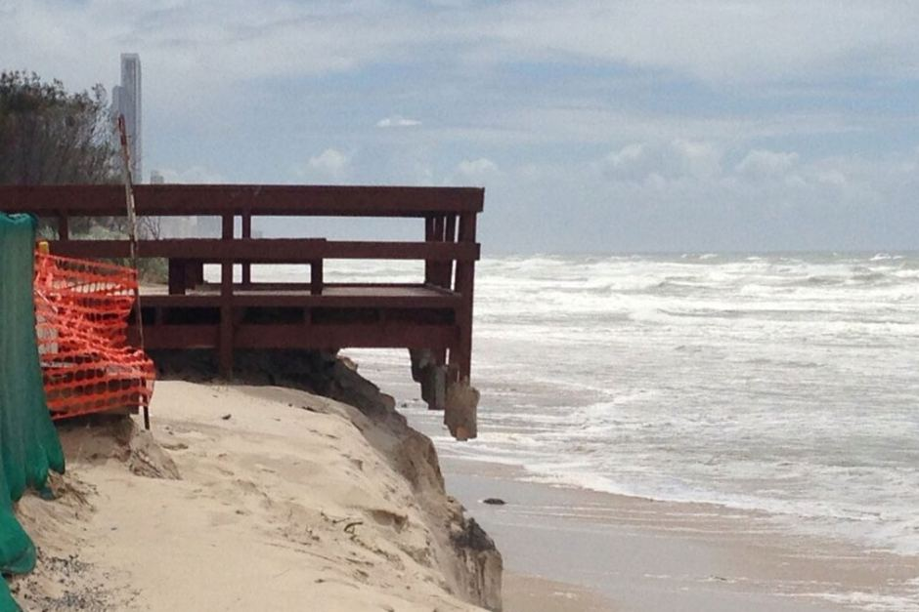
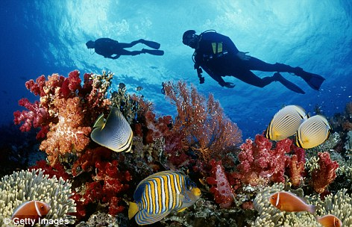
Introduction
Coral reef services:
House 25% of worlds fishes
Protect shorelines
Tourism
Treatment for diseases
http://www.bates.edu/biology/files/2015/02/Sea_Coral_Reef__Fish_Wallpaper_o76pu.jpg
http://www.abc.net.au/news/image/4551588-3x2-940x627.jpg
http://i.dailymail.co.uk/i/pix/2011/02/24/article-1360116-00F1CE34000004B0-729_472x304.jpg

Slide 3
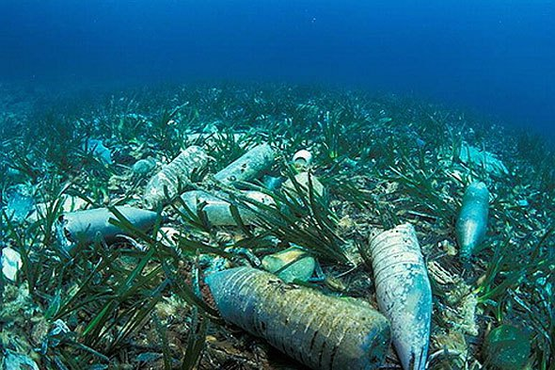
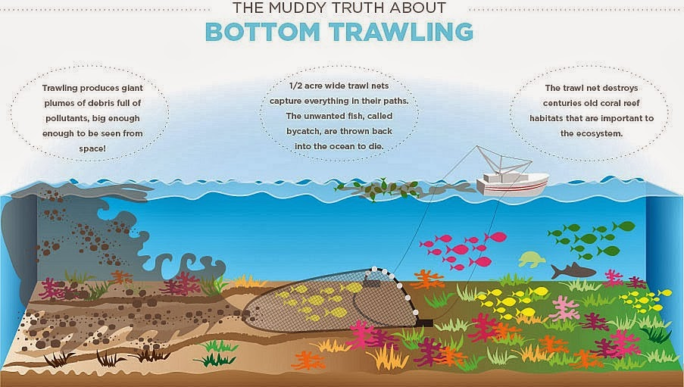
Introduction
Threats:
Destructive fishing practices
Careless tourism
Pollution
Climate change
http://2.bp.blogspot.com/-RySu1eM0Dyw/UkPLj44iwtI/AAAAAAAAKug/rQXP8crpCMc/s1600/bottom-trawling.jpg
http://kahlee93.weebly.com/uploads/5/0/0/5/50056413/5168988_orig.jpg

Slide 4
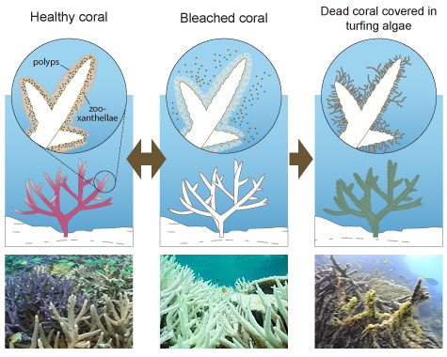
http://mission-blue.org/wp-content/uploads/2014/04/GBRMPA-Bleaching.jpg

Slide 5
Review of Literature
Coral naturally growing in a more thermally variable pool resisted heat stress, while coral from a more thermally moderate pool suffered high mortalities
Oliver and Palumbi, 2011

Slide 6
Review of Literature
Long-term increases in thermal tolerance decrease bleaching rates, much more so than temporary increases
Higher bleaching resistance has been found at sites that have experienced more frequent or devastating bleaching events in the past
Glynn, et al., 2001
Maynard et al., 2008
Thompson & van Woesik, 2009
Guest, et al., 2012
Logan, et al ., 2014

Slide 7
Review of Literature
In high temperature environments in American Samoa, most coral were able to host multiple symbiont types, including Symbiodinium clade D
Oliver and Palumbi, 2011
Constitutive front loading, or already expressed genes, allows an individual coral to maintain physiological resilience during frequently encountered stress
Barshis et al., 2013

Slide 8
Purpose
The purpose of this experiment is to determine whether coral from varying thermal environments still show differential bleaching tolerances after one year in a “common thermal garden”
Genetic adaptation vs. long-term acclimatization

Slide 9
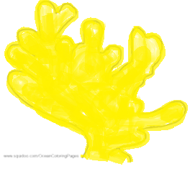
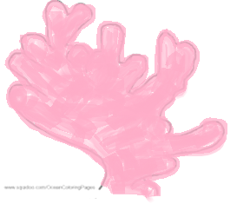
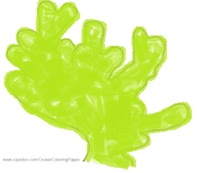
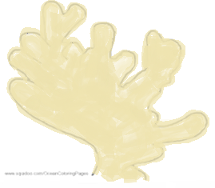
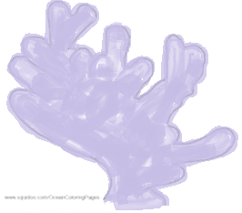
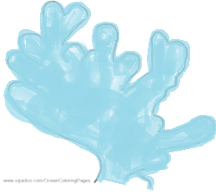
Methodology
Coral
Colony
Collection
Stress
Treatment
Tank Quality
Buoyant
Weighting
PCR
Statistics

Slide 10
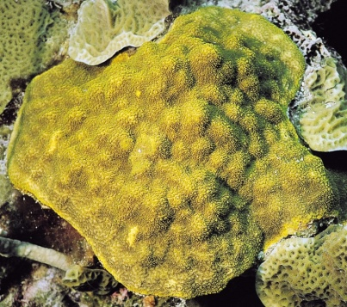
Methodology
http://commondatastorage.googleapis.com/aimscoral/images/largest/0603_C1_06.jpg
Coral Colony Collection:
Nine pairs of offshore cores & ten pairs of inshore cores of Porites astreoides from Florida and Belize
All coral were held in an aquatics facility at 27˚C, “common thermal garden” until experimentation
http://www.maguzz.com/2/map-of-florida-keys-and-caribbean.html

Slide 11
Methodology
Stress Treatment:
2 Control tubs: 27˚C and 2 heated tubs: 31˚C
18 fragments in each tank
4-5 inshore/offshore Belize & Florida in each
Constant water flow and artificial light
Experiment ran for total of 6 weeks

Slide 12
Methodology
Tank Quality
Sumps cleaned
Re-organized
Weekly Observations
pH levels
Nitrate
Phosphate
Alkalinity
Calcium Carbonate
http://Dramstime.com

Slide 13
Methodology
Buoyant Weighting:
Measured 2-3 times during 6 week treatment
Cleaned with toothbrush
Suspended in water

Slide 14
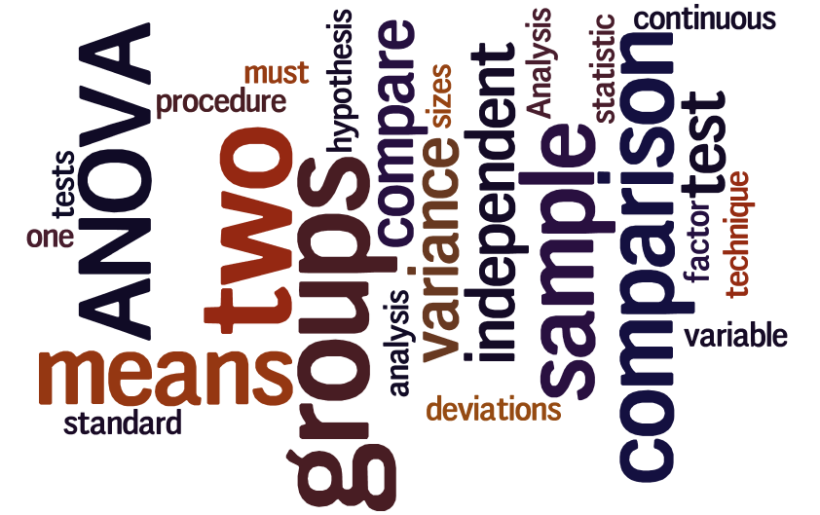
Methodology
Statistics:
Tw0 way ANOVA with replication comparing percent weight change
Inshore vs. offshore
Heated vs. Control
Interaction
http://sphweb.bumc.bu.edu/otlt/MPH-Modules/BS/BS704_HypothesisTesting-ANOVA/BS704_HypothesisTesting-Anova_print.html

Slide 15
Methodology
PCR:
Obtained coral DNA from frozen fragments
Ran a PCR and gel electrophoresis
Used PCR Product Cleanup sequenced DNA with Sequencher

Slide 16
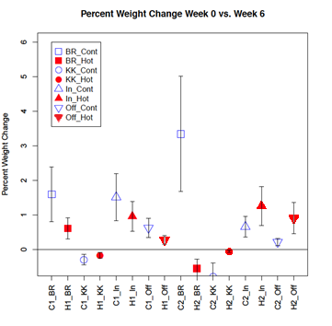
Data/Results

Slide 17
Data/Results
Belize ANOVA: Two-Factor With Replication
* Approaching Significance
** Statistically Significant (p < 0.05)

Slide 18
Data/Results
Florida ANOVA: Two-Factor With Replication
* Approaching Significance
** Statistically Significant (p < 0.05)

Slide 19
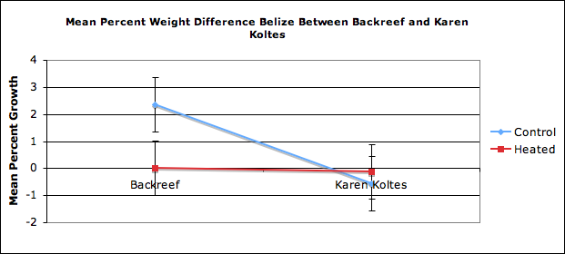
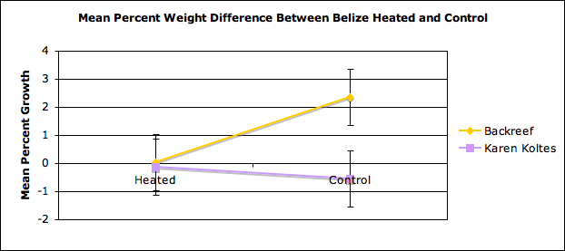
Data/Results

Slide 20
Data/Results

Slide 21
Data/Results
PCR:
A difference in the Symbiodinium composition between moderately variable and highly variable to pools to demonstrate that the differential bleaching response is genetic

Slide 22
Conclusion
Coral from a variable habitat in Belize and a variable habitat in Florida, separated by over 1100 km, show consistently greater tolerance of heat and treatment stress than coral from less variable habitats <5km away from each site
http://www.maguzz.com/2/map-of-florida-keys-and-caribbean.html

Slide 23
Conclusion
Temperature variability of the local habitat may predict a coral’s response to heat much better than even latitude, nationality, or other location factors

Slide 24
Discussion
Coral from thermally variable environments:
Possession of clade D
Constitutive frontloading

Slide 25
Discussion
Some samples may have not grown well under treatment conditions due to their questionable condition prior to the experiment.
Experiment should be repeated with modifications:
Run for a longer period of time
A larger sample size should be used
Different sampling method
Closer location
Alternate method for buoyant weighting

Slide 26
Discussion
Future:
Laws to protect more vulnerable coral
Reproduce coral with better ability to withstand heat

Slide 27
References
Back from the Dead: Remote Reef Recovers. (2013, April 10). Retrieved September 6, 2013, from Reef to Rainforest Media website: http://www.reef2rainforest.com/2013/04/10/back from-the-dead-remote-reef-recovers/
Barshis, D. J., Ladner, J. T., Oliver, T. A., Seneca, F. O., Traylor-Knowles, N., & Palumbi, S. R. (2013). Genomic basis for coral resilience to climate change. Proceedings of the National Academy of Sciences of the United States of America, 110(4), 1387-1392.
Coral Reefs: Rainforests of the Sea. (2007, June 5). Retrieved Jan 15, 2014, from Oceanic Research Group website: http://www.oceanicresearch.org/education/films/crrainspt.html
Hazards to Coral Reefs. (2012, December). Retrieved September 6, 2013, from National Oceanic and Atmospheric Administration website: http://www.coris.noaa.gov/about/hazards/
Jason Education Project (Ed.). (2004). Coral Reef Symbiosis. Retrieved from Ocean World website: http://oceanworld.tamu.edu/students/coral/coral3.htm
Kenkel, C. D., Goodbody-Gringley, G., Caillaud, D., Davies, S. W., Bartels, E., & Matz, M. V. (2013). Evidence for a host role in thermotolerance divergence between populations of the mustard hill coral (Porites astreoides) from different reef environments. Molecular Ecology, 4335-4348. http://dx.doi.org/10.1111/mec.12391
Ladner, J. T., Barshis, D. J., & Palumbi, S. R. (2012). Protein evolution in two co-occurring types of Symbiodinium: an exploration into the genetic basis of thermal tolerance in Symbiodinium clade D. BMC Evolutionary Biology. http://dx.doi.org/10.1186/1471-2148-12-217
Logan, C. A., Dunne, J. P., Eakin, M., & Donner, S. D. (2014). Incorporating adaptive responses into future projections of coral bleaching. Global Change Biology, 20(1), 1-http://dx.doi.org/10.1111/gcb.12390
Major Reef-building Coral Diseases. (2008). Retrieved September 6, 2013, from National Oceanic and Atmospheric Administration website: http://www.coris.noaa.gov/about/diseases/
Oliver, T. A., & Palumbi, S. R. (n.d.). Do fluctuating temperature environments elevate coral thermal tolerance? Reef Resilience. http://dx.doi.org/10.1007/s00338-011-0721-y
Oliver, T. A., & Palumbi, S. R. (2009). Distributions of stress-resistant coral symbionts match environmental patterns at local but not regional scales. Marine Biology Progress Series, 378, 93-103. http://dx.doi.org/10.3354/meps07871
Oliver, T. A., & Palumbi, S. R. (2011). Many corals host thermally resistant symbionts in high-temperature habitat. Coral Reefs, 30(1), 241-250. http://dx.doi.org/10.1007/s00338-010-0696-0
Palumbi, S. R., Barshis, D. J., Traylor-Knowles, N., & Bay, R. A. (2014). Mechanisms of reef coral resistance to future climate change. Science, 344(6186), 895-898. http://dx.doi.org/10.1126/science.1251336
Threats to Coral. (2012). Retrieved September 6, 2013, from Endangered Species International website: http://www.endangeredspeciesinternational.org/coralreefs7.html
What are Coral Reefs. (2012, Fe). Retrieved September 6, 2013, from National Oceanic and Atmospheric Administration website: http://www.coris.noaa.gov/about/what_are/
Why Care about Coral Reefs? (2013). Retrieved September 6, 2013, from Coral Reef Alliance website: http://www.coral.org/resources/about_coral_reefs/why_care

Slide 28
Acknowledgements
I would like to thank my mentor, my Science Research teachers, and my parents for assisting me in all my scientific endeavors their continued support for my research.

Slide 29
Differences in percent weight growth of the Mustard Hill coral (Porites astreoides) from contrasting thermal environments after adaptation in a “common thermal garden”
Pratima Rosen

