Slide 1
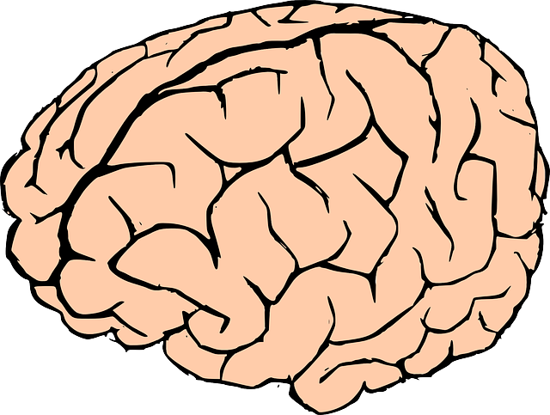
The Effects of Nicotine on NMDA Receptor Expression in the Brain and Peripheral Blood Lymphocytes of Mice as a Possible Treatment for Schizophrenia
Celia Hutchins

Slide 2
Introduction
Schizophrenia is a severe neuropsychiatric disease that affects one percent of the general population.
The disease is characterized by:
Positive symptoms
Negative symptoms
Cognitive deficits

Slide 3
Introduction
A current model for schizophrenia involves N-methyl–D-aspartate Receptor (NMDAR) hypofunction.
Na⁺
Ca⁺²
K⁺
Extracellular
Glutamate
Glycine
Plasma Membrane
Mg⁺²
Intracellular
Na⁺
K⁺
Ca⁺²

Slide 4
Review of Literature
Current antipsychotic treatments improve positive symptoms, but have limited efficacy for the negative symptoms and cognitive deficits of schizophrenia.
(Buchanan, et al., 2007)

Slide 5
Review of Literature
People with schizophrenia are three times more likely to smoke cigarettes than the rest of the world population (75%-90% vs. 25%-30%), indicating that smoking may be a way of self-medicating.
(Smith, et al., 2002)

Slide 6
Review of Literature
Acute smoking of a cigarette has been shown to have the effect of reducing negative symptoms in patients with schizophrenia, with a stronger effect from the cigarette that had higher nicotine content.
(Smith, et al., 2002).

Slide 7
Hypothesis
Mice injected with nicotine will show altered levels of the NMDAR mRNA expressed in their brain tissue and peripheral blood lymphocytes.

Slide 8
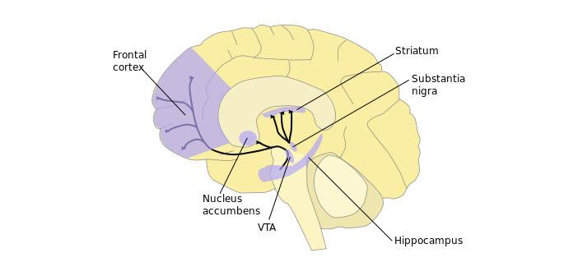
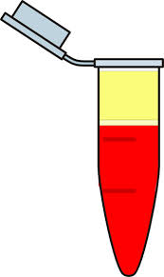
Methodology
Right Striatum
6 injected with nicotine as an experimental group, and 6 injected with saline as a control group.
Blood Plasma
6 injected with nicotine as an experimental group, and 6 injected with saline as a control group.
Left Hippocampus
6 injected with nicotine as an experimental group, and 6 injected with saline as a control group.
Prefrontal Cortex
2 injected with nicotine for the experimental group, and 2 injected with saline as a control group.
http://www.psypost.org/2014/10/happens-hippocampus-28572#prettyPhoto
http://lspolicy1.lhric.org/access/web?id=7e7e37ca-9dcf-11e5-bf0c-00e0ed27d4e8

Slide 9
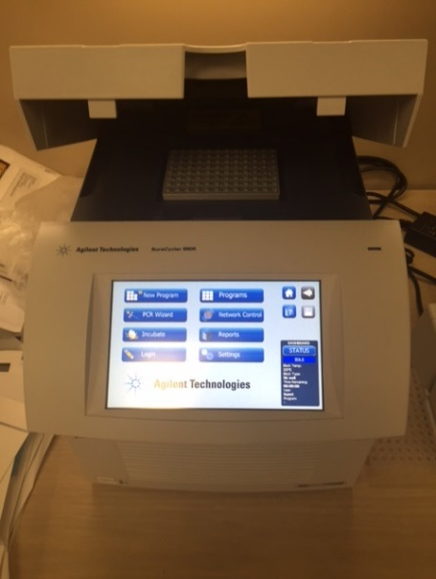
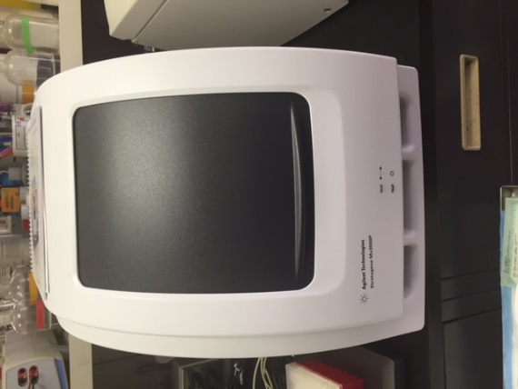
Methodology
RNA converted to cDNA using the Agilent Technologies Sure Cycler 8800 and SuperScript® VILO cDNA Synthesis Kit and Master Mix.
cDNA analyzed using Agilent Technologies Mx3000P qPCR and primers for β- actin and Grin 1 to find NMDAR mRNA expression levels.
Data analyzed using a 2∆∆ct test, determines the factor by which the experimental group NMDAR mRNA was up-regulated compared to the control group.
RNA extracted using the Trizol RNA Isolation Protocol.

Slide 10
Results
Table 1: (C_{t}) values for the samples corrected, and analyzed
* Indicates data that is Statistically Significant (p< 0.05)
**Indicates data that is approaching statistical significance
Average (∆ct) (ct Grin 1 - ct β-Actin)
 | Prefrontal Cortex | Left Hippocampus | Right Striatum
Sample 1 (Control) | 1.34 | 2.24 | 2.69
Sample 2 (Control) | 1.55 | 2.17 | 2.15
Sample 3 (Control) |  | 2.36 | 2.83
Sample 4 (Control) |  | 1.70 | 2.18
Sample 5 (Control) |  | 2.47 | 2.10
Sample 6 (Control) |  | 2.14 | 3.45
Sample 7 (Experimental) |  | 2.47 | 2.02
Sample 8 (Experimental) |  | 1.09 | 1.92
Sample 9 (Experimental) |  | 2.37 | 1.96
Sample 10 (Experimental) |  | 1.32 | 2.09
Sample 11 (Experimental) | 1.16 | 2.22 | 2.19
Sample 12 (Experimental) | 1.07 | 2.32 | 1.57
Average ∆ct Control | 1.45 | 2.18 | 2.57
Average ∆ct Experimental | 1.11 | 1.97 | 1.96
Standard Deviation (Between the control and experimental groups) | 0.235 | 0.153 | 0.429
Standard Deviation based on 2^{-ct} | 0.0673 | 0.0394 | 0.0539
∆∆ct (∆ct Experiment – ∆ct Control) | -0.333 | -0.216 | -0.607
Fold Change (2^{-∆∆ct}) | 1.26 | 1.16 | 1.52
P-Value from t-test |  | 0.210
P-Value from t-test based on 2^{-ct} |  | 0.172
**0.0510
*0.0147
*0.0459
*0.0101

Slide 11
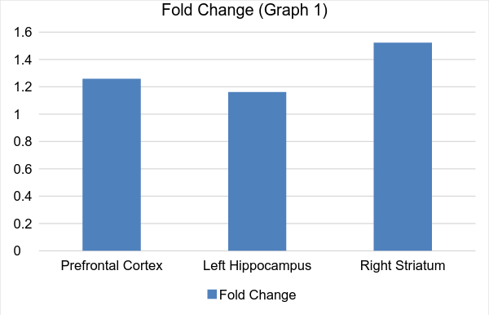
Results
Figure 6: Factor by which the NMDA receptor expression levels of the experimental mice were up-regulated compared to the controls
= Statistically significant at p value < 0.05 using the numbers given
= Statistically significant at p value < 0.05 based on 2^{-∆ct} form
= Approaching statistical significance using the numbers given

Slide 12
Results
No data was collected for the peripheral blood lymphocytes, because the values for NMDAR mRNA expression were below threshold level.

Slide 13
Conclusion
The levels of mRNA for NMDARs expressed in mice injected with nicotine were higher than those in the control mice.
These results support the hypothesis that nicotine alters the level of the NMDARs being expressed in certain parts of the brain.

Slide 14
Conclusion
This suggests that nicotine could be used as a possible treatment to improve NMDARs’ functioning.

Slide 15
Discussion
The study also points towards a direction for further inquiries into the development of new treatments.
The results of this study also provide evidence that patients who smoke could be using it as a way to self-medicate.

Slide 16
Discussion: Validity
In order to increase the validity of the results, more tests could be run:
Using more samples.
Examining different parts of the mouse brains.
By subjecting the mice to nicotine for a longer period of time.
Using a more reliable method of isolating the RNA.

Slide 17
Discussion: Further Research
Further research could include:
testing to determine why the cDNA used to analyze the peripheral blood lymphocytes were below the threshold.
testing to see if nicotine treatment has harmful, long-term effects.
Testing the interaction between nicotine and current treatments.

Slide 18
Discussion: Further Research
Further research could include:
testing the peripheral blood lymphocytes of post-mortem brain samples in patients with schizophrenia versus a control group.
testing a group of smokers with schizophrenia versus a group of non-smokers with schizophrenia.

Slide 19
Acknowledgements
I would like to thank my mentor Dr. Henry Sershen at Nathan Kline Institute for Psychiatric Research for his guidance and my teachers Ms. Kleinman, Ms. Foisy, and Ms. O'Hagan, along with my parents, for their support towards the completion of this project.

Slide 20
References
Buchanan, RW., Javitt, DC., Marder. SR., Schooler., NR., Gold, JM., McMahon, RP., Heresco-Levy, U., Carpenter, WT. “The Cognitive and Negative Symptoms in Schizophrenia Trial,”2007. Am J Psychiatry. 164. 1593–1602.
Chana, G., Bousman, CA., Money, TT., Gibbons, A., Gillett, P., Dean, B., Everall, IP., “Biomarker investigations related to pathophysiological pathways in schizophrenia and psychosis.” 2013. Front. Cell. Neurosci, 7: 95. 1-18.
Chomczynski, P., Mackey, K., “Modification of the TRIZOL reagent procedure for isolation of RNA from Polysaccharide-and proteoglycan-rich sources.” 1995. Biotechniques 19(6), 942-945.
Citrome, L., “Unmet Needs in the Treatment of Schizophrenia: New Targets to Help different Symptom Domains,” 2014. Clinical Psychiatry. 75. 21-26.
Falkenberg, L.E., Westerhausen, R., Craven, AR., Johnsen, E., Kroken, RA., L. Berg, EM., Specht, K., Hugdahl, K., ‘‘Impact of glutamate levels on neuronal response and cognitive abilities in schizophrenia.” 2014. NeuroImage: Clinica. 4. 576–584.
Leonard, S., Mexal, S., Frank, M., Berger, R., Adams, CE., Ross, RG., Freedman, R., “Differential Modulation of Gene Expression in the NMDA Postsynaptic Density of Schizophrenic and Control Smokers.” 2005. Brain Res Mol Brain Res. 139. 317-332.

Slide 21
References
Levin, E., Rezvani, A., “Nicotinic Interactions with Antipsychotic Drugs, Models of Schizophrenia and Impacts on Cognitive Function.” 2007. Biochem Pharmacol. 74(8). 1182-1191.
Mathalon, Daniel H., Ahn, KH., Perry, EB., Cho, HS., Roach, BJ., Blais, RK., Bhakta, S., Ranganathan, M., Ford, JM., D'Souza, DC., “Effects of Nicotine on the Neurophysiological and Behavioral Effects of Ketamine in Humans.” 2014. Frontiers in Psychiatry. 5. 1-16.
Noetzel, Meredith J., Jones, CK., Conn, PJ., “Emerging Approaches for Treatment of Schizophrenia: Modulation of Glutamatergic Signaling.” 2012. Discovery Medical. 14(78), 335-343.
Risso, Francesca, Grilli, M., Parodi, M., Bado, M., Raiteri, M., Marchi, M., “Nicotine exerts a permissive role on NMDA receptor function in hippocampal noradrenergic terminals.” 2004. Neuropharmacology. 47. 65–71.
Siegal, Steven, Ehrlichman, RS., Liang, Y., Christian, EP., Jonak, GJ., Gur, TL., Blendy, JA., Dow, HC., Brodkin, ES., Schneider, F., Gur, RC., Siegel, SJ., “Assessment of NMDA Receptor NR1 Subunit Hypofunction in Mice as a Model for Schizophrenia.” 2009. Genes Brain Behav. 8(7). 661-67.
Smith, Robert C., Singh, A., Infante, M., Khandat, A., Kloos, A., “Effects of Cigarette Smoking and Nicotine Nasal Spray on Psychiatric Symptoms and Cognition in Schizophrenia.” 2002. Neuropsychopharmacology. 27. 479–497.

Slide 22
The Effects of Nicotine on NMDA Receptor Expression in the Brain and Peripheral Blood Lymphocytes of Mice as a Possible Treatment for Schizophrenia.
Celia Hutchins

