Slide 1
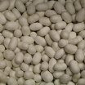
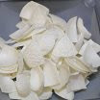
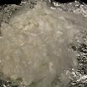
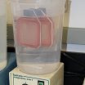
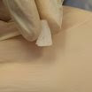
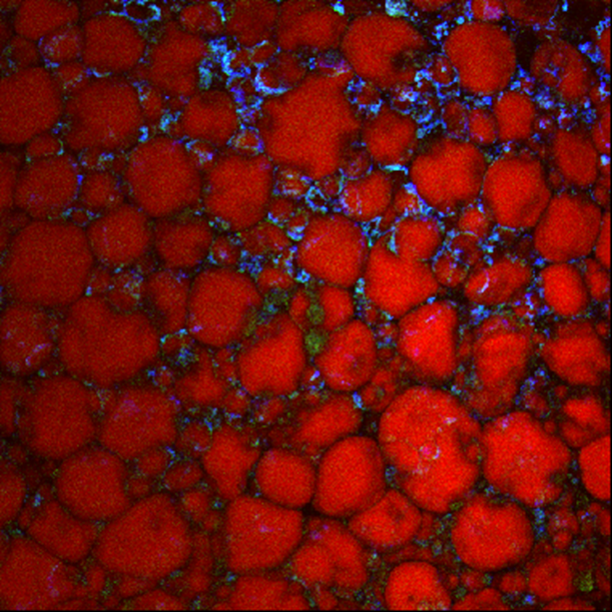
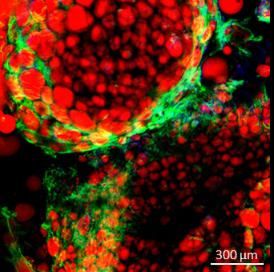
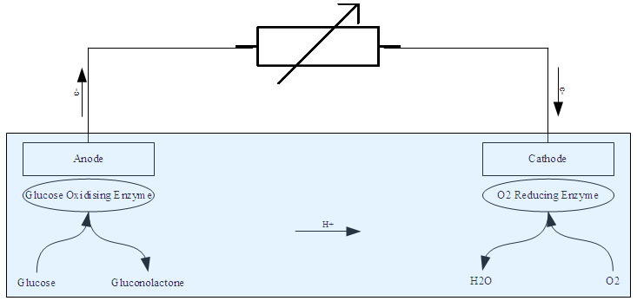
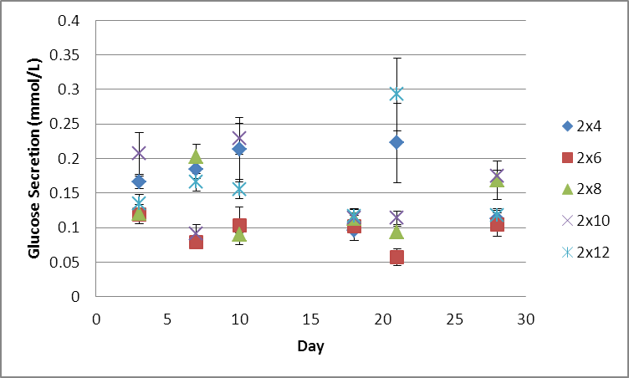
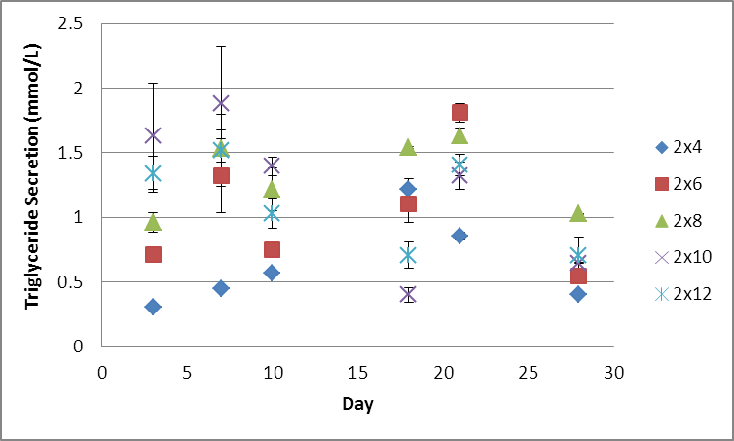
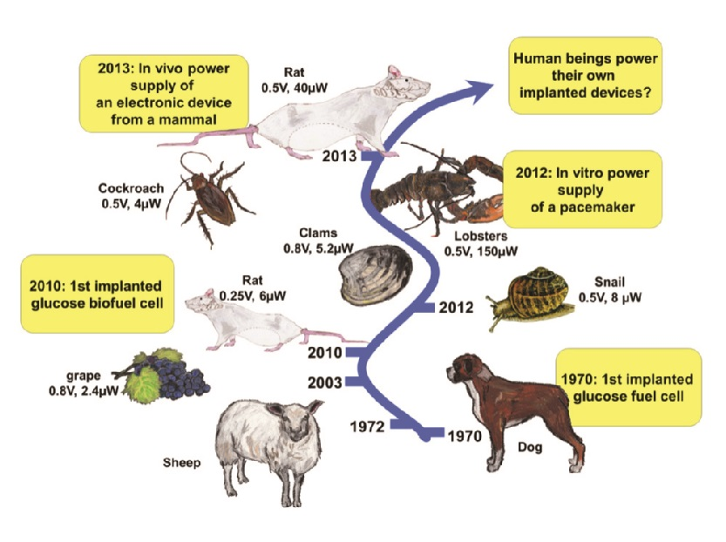
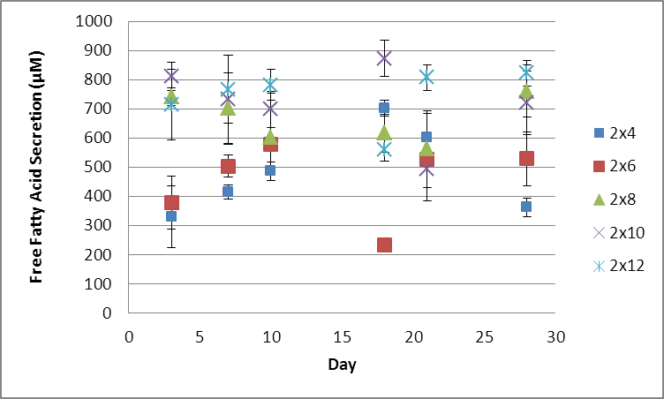
Secretion of Organic Compounds from Tissue Engineered Adipose on Silk Scaffolds of Differing Sizes Compared to Differing Culture Periods
Introduction
Materials & Methods
Implantable medical devices
The medical field is heavily reliant on implantable medical devices that require electricity to run
600,000 pacemakers implanted worldwide each year
(Wood et al., 2002)
Powered by lithium iodide or lithium anode cells
Must be surgically replaced every five years
Biofuel cells
Biofuel cells could replace conventional batteries and allow implanted device to work independently without requiring outside sources to recharge it
Biofuel cells use enzymes as the catalyst of the cell. There are many advantages to using enzymes as catalysts rather than metals. Enzymes can be made in abundance, and can more easily interact with other organic compounds than metals (Zebda et al., 2013)
Silk cocoons from bombyx mori silk worms
Silk cocoons cut into dime sized pieces
Silk fibroin after the sericin has been removed using Na₂CO₃
Silk fibroin during dialysis to remove the LiBr added to liquefy the silk
Finished scaffold
What is donated from an abdominoplasty
Dissected out fat about to be blended
Confocal imaging of adipocytes seeded on silk scaffolds. Red is AdipoRed, green is Phalloidin, Blue is DAPI, and purple is silk. Scale bars are 300 µm and 150 µm respectively.
Results
Summary & Conclusions
Knowing the concentrations secreted helps to evaluate what scaffold size and culture period should be used on the eventual fuel cell .
Over time, secretion increased steadily.
2x6mm scaffolds were the most unpredictable.
Most successful scaffolds for glucose and free fatty acid were scaffolds size 2x10mm or 2x12mm, around day 18 or 21.
The glycerol secretion was most successful in scaffolds size 2x6mm and 2x10mm.
According to ANOVA analysis and Tukey’s Honestly Significant Difference between scaffold size and culture period are significant, suggesting that these factors can be optimized.
http://en.wikipedia.org/wiki/Enzymatic_biofuel_cell#mediaviewer/File:General_Enzyme_Fuel_Cell_Diagram.png
Review of Literature
Glucose biofuel cells directly implanted in rats were able to use the rat’s bodily fluids as the only source of power for an LED (Zebda et al., 2013)
Fat is the largest energy reserve in the human body (Horowitz et al., 2003)
Adipose tissue is made up of adipocytes, which are characterized by their large lipid droplet (Horowitz et al., 2003)
Silk Fibroin is a commonly used biomaterial due to its high biocompatibility and mechanical properties (Kaplan et al., 2011)
Glucose:
Overall: 21 days & 2x12mm: 0.203 mmol/L
Highest averages: 2x4mm & 10 days
HSD:
Difference in average concentration between each scaffold size
Difference in average concentration between each culture period except days 3 and 7
Triglyceride:
7 days & 2x10mm: 1.878 mmol/L
Highest averages: 2x8mm & 21 days
HSD:
Difference in average concentration between the small scaffold sizes
Difference in average concentration between all culture periods except for days 10 and 18
Future Work
Summary:
These assays should be repeated and more time points should be sampled to get more accurate results.
Studies should look into the effects of pore size on the secretion of the same three organic compounds.
Research is needed to dictate what organic compound the biofuel cell will rely on most.
Future work includes designing the biofuel cell, testing the cell in vitro, testing the cell in vivo in animals, and finally testing the cell in vivo in humans .
Free Fatty Acid Statistics
Source of Variation | SS | df | MS | F | P-value
Culture Period | 1462579.75 | 4 | 365644.936 | 17.8225157 | <.01
Scaffold Size | 383986.120 | 5 | 76797.2399 | 3.74330363 | <.01
Interaction | 1189198.74 | 20 | 59459.9372 | 2.89823695 | <.01
Within | 1230953.95 | 60 | 20515.8992
Total | 4266718.64 | 89
An Implantable Biofuel Cell for a Live Insect Michelle Rasmussen, Roy E. Ritzmann, Irene Lee, Alan J. Pollack, and Daniel Scherson Journal of the American Chemical Society 2012 134 (3), 1458-1460
Purpose
The purpose of this project was to determine the feasibility of engineering adipocyte cells that secrete concentrations of organic compounds that will be beneficial to the biofuel cell.
Glucose
Free Fatty Acid
Triglyceride
Free fatty acid:
18 days & 2x10mm: 872.733 µM
Highest averages: 2x12mm & 28 days
HSD:
Difference in average concentration between larger and smaller scaffold sizes
No significance in average concentration between culture periods
The p-values for culture period, scaffold size, and the interaction between the two were highly significant for all organic compounds
References
HSD results were varying between organic compound types
An Implantable Biofuel Cell for a Live Insect Michelle Rasmussen, Roy E. Ritzmann, Irene Lee, Alan J. Pollack, and Daniel Scherson Journal of the American Chemical Society 2012 134 (3), 1458-1460
Cahill, G. F. Metabolic Role of Adipose Tissue. Trans Am Clin Climatol Assoc., 1962(73), 22-29
Zebda, A., Cosnier, S., Alcaraz, J. P., Holzinger, M., Le Goff, A., Gondran, C., & Boucher, F. (2013, March 22). Single Glucose Biofuel Cells Implanted in Rats Power Electronic Devices. Scientific Reports, 3(1516), 1-5. doi:10.1038/srep01516
Horowitz, J. F. (2003, October). Fatty acid mobilization from adipose tissue during exercise. TRENDS in Endocrinology and Metabolism, 14(8), 386-392. doi:10.1016/S1043-2760(03)00143-7
Cosnier, S., Le Goff, A., & Holzinger, M. (2013, September 17). Towards glucose biofuel cells implanted in human body for powering artificial organs: Review. Elsevier, 2014(38), 19-23.

